Slide 1
Terraform Tech Talk
Sean Connelly
Notes:
Welcome to my talk on Terraform
I’ve used terraform since 2019
To head off questions: I have not tried OpenTofu but from what I know it’s minimally different and won’t impact us as we aren’t reselling terraform as our own service. I am happy to gossip about the drama at the end if we finish early.

Slide 2
Infrastructure as Code
IaC vs CaC
Benefits
Configuration as Code
Focus: manage/maintain software and system configs.
Examples: PowerShell DSC, Ansible, Chef
Infrastructure as Code
Manages underlying infra (servers, networks) and their configs.
Complements cloud IaaS platform offerings.
Examples: Tf, Bicep, Arm
Consistency and repeatability in environments.
Speed and Efficiency with Auditable Deployments.
Reduced human error and enhanced collaboration.
Notes:
IaC and CaC are unlike other languages in that they are simple, declarative rather than imperative, and describe the intended infrastructure configurations in human readable terms.
Configuration as Code by itself would expect servers to be more stateful, already running and not be removed or recreated.
Infrastructure as Code is more wholistic than Config as code. It is excellent for scaling repeatable environments on demand where Config as code by itself, would not help with scaling up new resources.

Slide 3
Terraform Benefits by comparison
Terraform
ARM/Bicep
Platform: Multi-Cloud
Uses Hashicorp Configuration Language
State Management of managed resources, including cleanup
Rich provider ecosystem: Cloudflare, Datadog, GitHub, Octopus Deploy, Kubernetes, Helm, Ansible (currently 4,289 providers)
Platform: Azure specific
Language: Bicep (domain specific)
Uses ARM to check state of azure resources in current run. No cleanup for resources removed between runs.
Notes:
You might be wondering why you should use terraform over something native to your platform which for many here is Azure.
I’d counter with that are you sure you only need that one platform? Why tie yourself to one when you might want to move later?
Platform specific tools require specialized non-transferable investments of effort to build knowledge, and time to document the configuration in the tool.
Being cloud agnostic, you can shift a platform in terraform from one service like AKS to another like ECS.
HCL is basically yaml, it’s simple to write, like making a grocery list.
State Management with Terraform lets you track terraform managed resources, the state you expect them to be in when you start a run, query the state they are currently in, and make a delta to get to the state you want them to be in. In this way you can manage resources more durably and make iterative changes in source control to roll out to environments. If you remove a resource from a terraform deployment the resource is deleted in the next run, but if you remove a resource from a bicep deployment the resource is no longer tracked and is left unmanaged.

Slide 4
Terraform features to know
State Files
TFCloud, Locally, Cloud (Azure)
Providers
Pin provider version to protect against breaking changes
Navigating Provider Registry
Modules
Variables and Locals
Variables are known at the start
Locals are computed at runtime
Notes:
State files
What they are
How to store them
You could use terraform cloud, but their pricing model gets expensive as you manage more resources.
You can only store it locally if you’re running it locally, if you want it to be a part of a pipeline it needs a cloud storage location.
we’ve been setting ours up in Azure Storage and calling/manipulating them from there to avoid those costs.
Reference them in other configurations – You can call a state file from another run to pull outputs for a different stage. When setting up an AKS cluster you should separate the underlying infrastructure from the Kubernetes configuration on top, because if your Kubernetes configuration is broken through manual changes outside of terraform, it’ll break the state checking preventing you from even redeploying the underlying hardware to rebuild the cluster.
Providers
These are the representations for the upstream APIs, they interact with the apis and manage resources on your behalf.

Slide 5
Design Patterns for Deployments Credit: Rosemary Wong
Singleton
Composite
Most Simplistic
Declares a set of resources as singular instances in a system.
Deploys all resources with a single command
You want to create a single set of resources with fixed desired values.
Leverages reusable prebuilt parameterized modules to deploy resources quickly.
Custom modules can be leveraged by multiple workflows.
Workflows can use versioned modules, and maintainers can update from a single point.
Notes:
Singleton Example
Building dev resources: Resource Group, and Web App.
Composite Example:

Slide 6
Design Patterns for Deployments
Factory
Prototype
Factories let you churn out repeatable sets of resources based on inputs and constraints.
Useful for high volume requests.
Highly Parameterized, likely called by another function.
Export values rather than create resources.
Reference Data Resource Outputs.
Build complex objects for ingestion downstream.
Notes:
Factory example: If you need to host a website per customer with minimal variation between client, you could create a factory that accepts a couple of inputs like $client_name, and then build out all of the resources with that variable in mind to stamp out thousands of sites from a list, and then create new ones with an onboarding form.
Prototype example: If you want to tag resources, you might pull all untagged resources, then tag them with a given value.

Slide 7
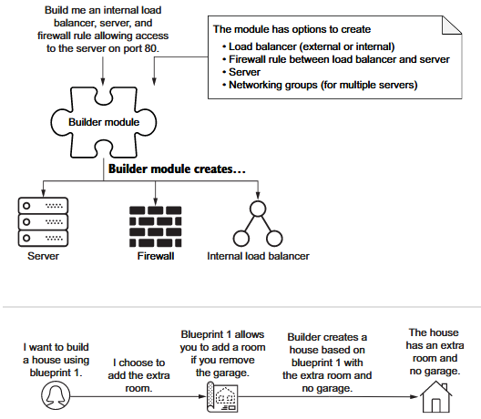
Builder Design Pattern
Most Complex, and powerful, but allows flexibility.
Blend of Composite and Factory with variable configuration based on parameters.
Allows you to scale out highly complex sets of resources for new clients/environments, and lets you manage those clients durably, updating configurations from central modules.
Notes:
I built a terraform repo that could build one of three configurations: A full standalone environment, the base infrastructure for an environment, and the applications and configurations to apply to an environment. This way the same terraform repo could create new standalone clients, new shared regions to put clients on, or add new clients to existing infrastructure regions, all based on a parameter.

Slide 8
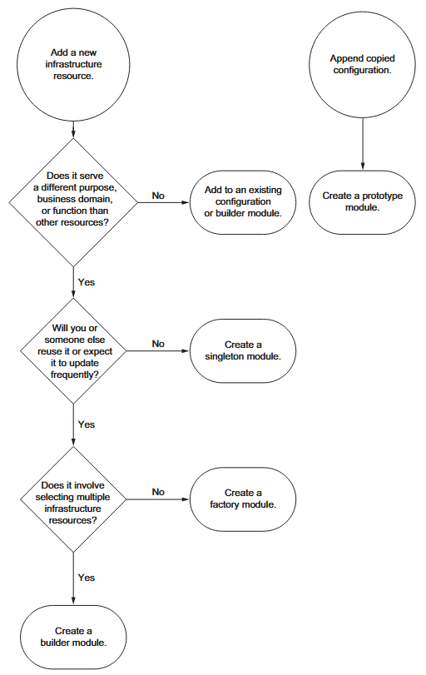
Choosing the right build pattern
Considerations: purpose, reuse, update frequency, resource composition.
Balance standard attributes with flexibility.

Slide 9
Demo
Problem: Running low on GitHub Action Minutes
Solution: For Each repo, create a self-hosted GitHub Runner using Azure Container Apps using consumption tier.
Notes:
Show:
GitHub provider – Explain how it authenticates using the env variable GITHUB_TOKEN from GitHub Actions
Github_repositories data resource – Show how I’m pulling all repo names and sending it to an output.
Azure Container App Env
Standard resources – rg, log analytics workspace, and a single app env.
Local that drops the owner portion, and truncates to the first 15 characters of the repo name. This way I can use these values in container names.
Container app
For_each meta argument https://developer.hashicorp.com/terraform/language/meta-arguments/for_each
Passing each.value in to pass the name I want.
Registry data resource - for referencing registry durably
User Assigned Identity – with role to pull from registry, and provide that access to container app.
Backend State File in Azure

Slide 10
Recommended Learning Resources
HashiCorp Terraform Azure Tutorial
Infrastructure as Code – Rosemary Wong

